Slide 1
University of Basrah
AL-Zahraa College of Medicine
Ministry of higher Education and Scientific Research
Cardiorespiratory Care Block
Lecture title: how to read an ECG
Date: 27/3/2022
Dr. Mohammed Adil
CRC Block Staff:
Dr Firas Rashid Sayil (block leader)
Dr. Mohammed Adil
Dr Assad Hassan
Dr Ahmed Qassim
Dr Safa Asaad
Dr Mustafa Ghazi
Dr Ilham Mohammed
Dr Zainab Muzahim
Dr. Ahmed Bader
Dr Nawal Mustafa
Dr Zainab Almnaseer
Dr Farqad Alhamdani
Dr Ban M. Saleh
Dr Amani Namaa
References as in the workbook and classroom.
For more detailed instruction, any question, cases need help please contact block leader at the CRC Google classroom or email.

Slide 2
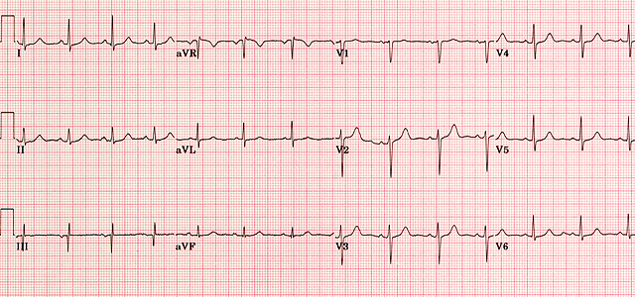
University of Basra
AL-Zahraa College of Medicine
Ministry of higher Education and Scientific Research
First check the name and date of the ECG
Check calibration ,speed and voltage (normal 25msec,10 mmvol)
Check Connection

Slide 3
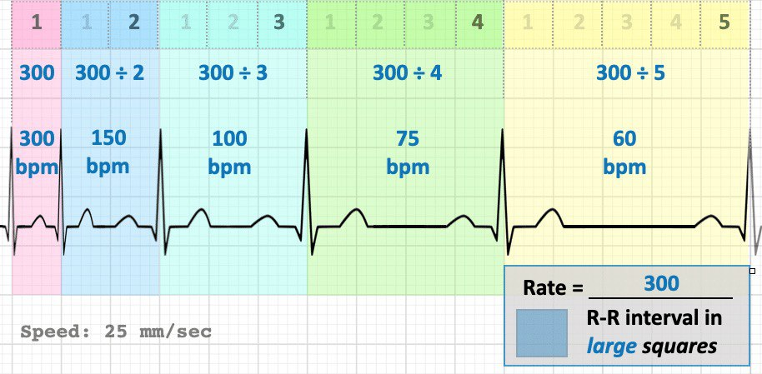
University of Basra
AL-Zahraa College of Medicine
Ministry of higher Education and Scientific Research
Check the rythem (regular or irregular)
Calculate the rate :

Slide 4
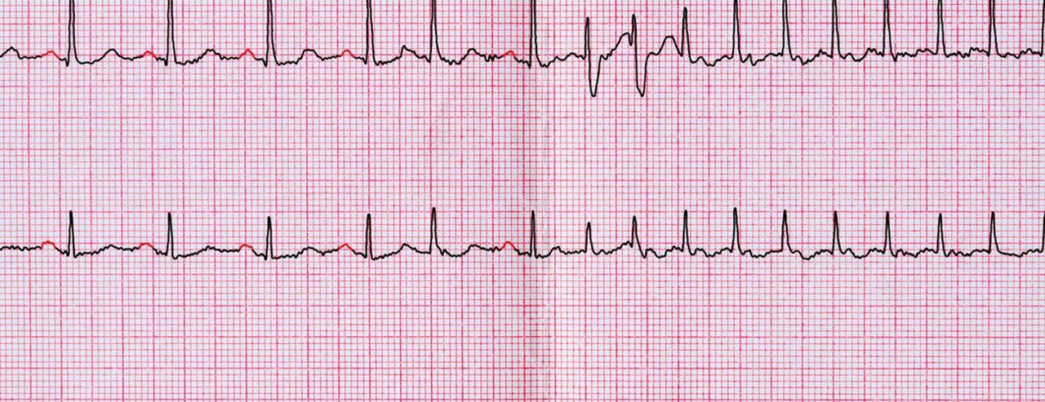
University of Basra
AL-Zahraa College of Medicine
Ministry of higher Education and Scientific Research
Calculate the rate :

Slide 5
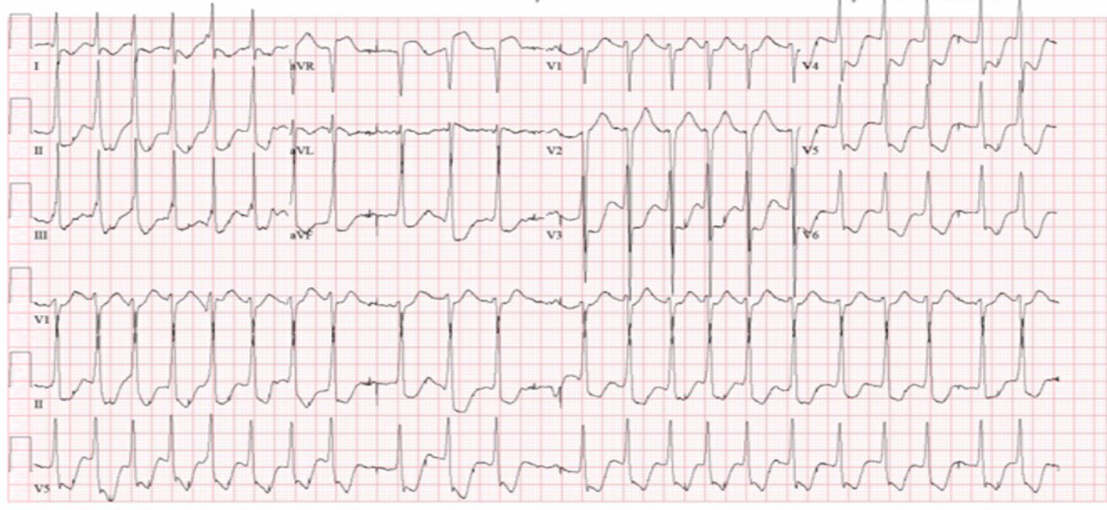
University of Basra
AL-Zahraa College of Medicine
Ministry of higher Education and Scientific Research
Check p wave if present of absent : if absent think about SVT(regular RR interval ) or AF (irregular RR interval)

Slide 6
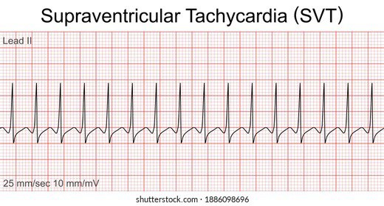
University of Basra
AL-Zahraa College of Medicine
Ministry of higher Education and Scientific Research

Slide 7
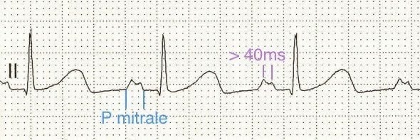
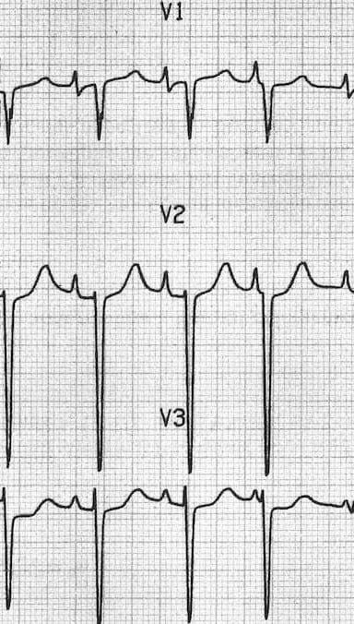
University of Basra
AL-Zahraa College of Medicine
Ministry of higher Education and Scientific Research
If p wave present than check its morphology than check the PR interval

Slide 8
University of Basra
AL-Zahraa College of Medicine
Ministry of higher Education and Scientific Research
If PR prolong > 3 small square than heart block :
First degree heart block

Slide 9
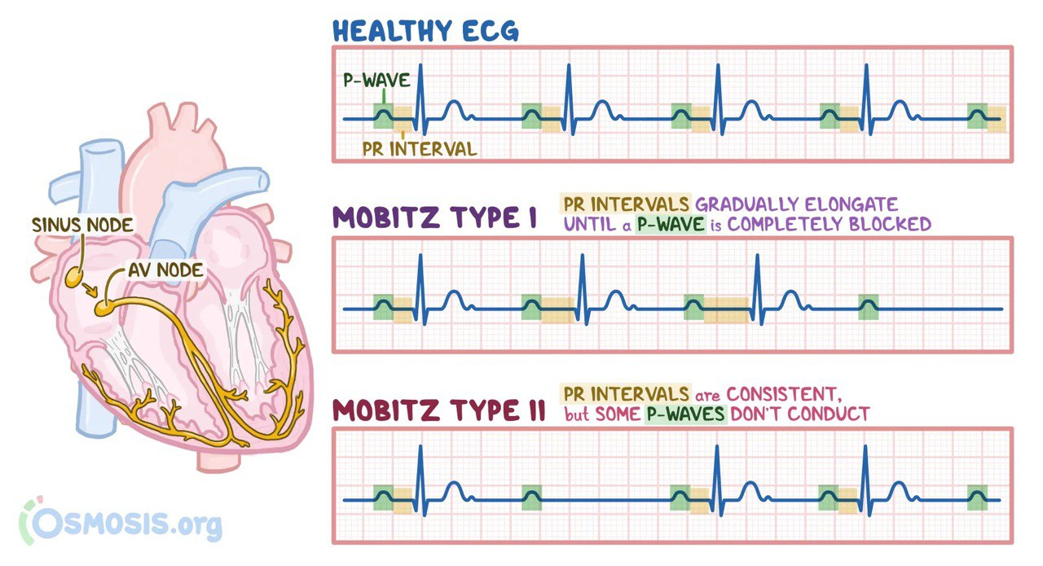
University of Basra
AL-Zahraa College of Medicine
Ministry of higher Education and Scientific Research

Slide 10
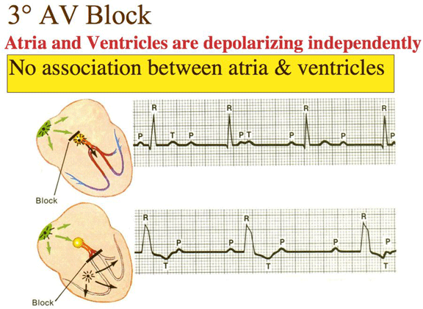
University of Basra
AL-Zahraa College of Medicine
Ministry of higher Education and Scientific Research

Slide 11
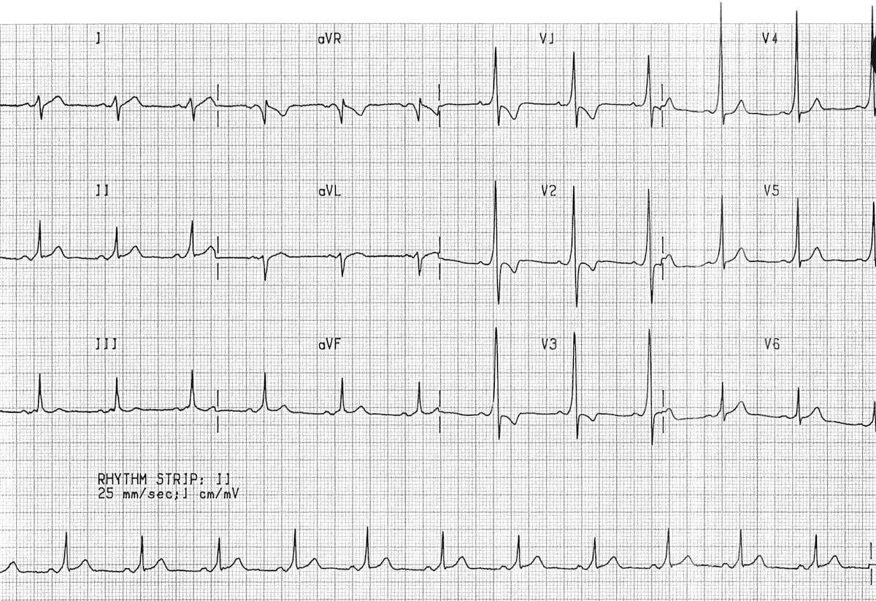
University of Basra
AL-Zahraa College of Medicine
Ministry of higher Education and Scientific Research
If PR interval short think about WPW:

Slide 12
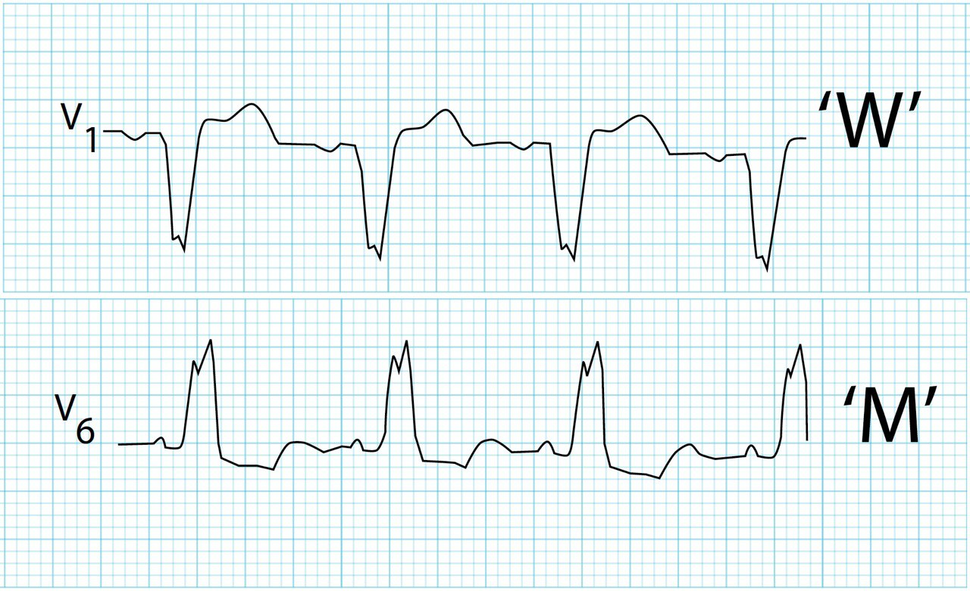
University of Basra
AL-Zahraa College of Medicine
Ministry of higher Education and Scientific Research
Check QRS normal width < 3 small square:

Slide 13
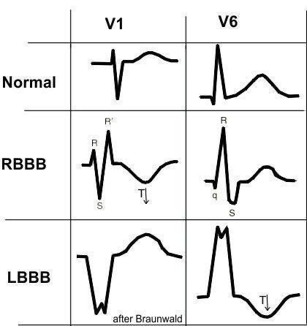
University of Basra
AL-Zahraa College of Medicine
Ministry of higher Education and Scientific Research

Slide 14
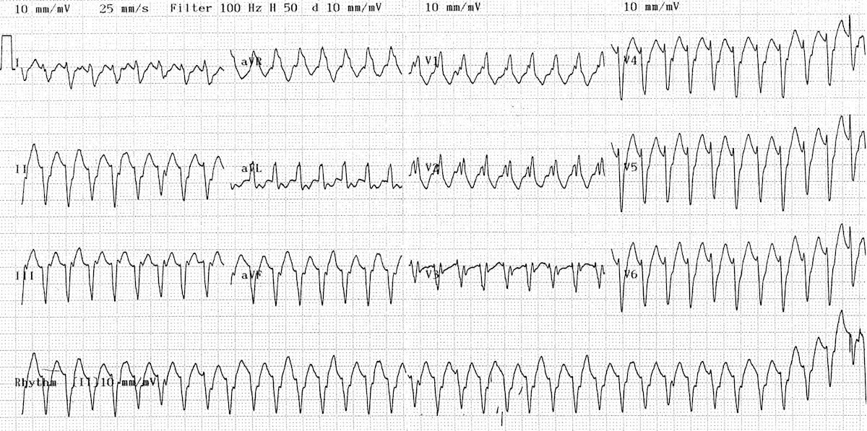
University of Basra
AL-Zahraa College of Medicine
Ministry of higher Education and Scientific Research

Slide 15
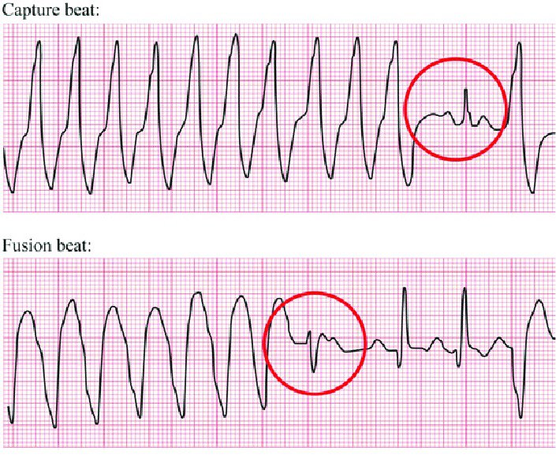
University of Basra
AL-Zahraa College of Medicine
Ministry of higher Education and Scientific Research

Slide 16
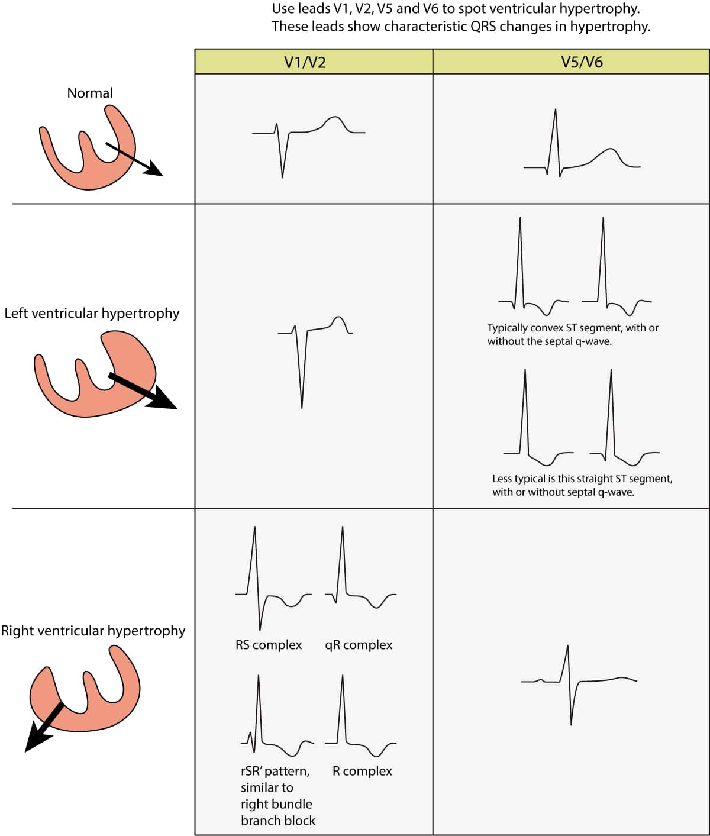
University of Basra
AL-Zahraa College of Medicine
Ministry of higher Education and Scientific Research
Check amplitude of QRS especially in chest leads:

Slide 17
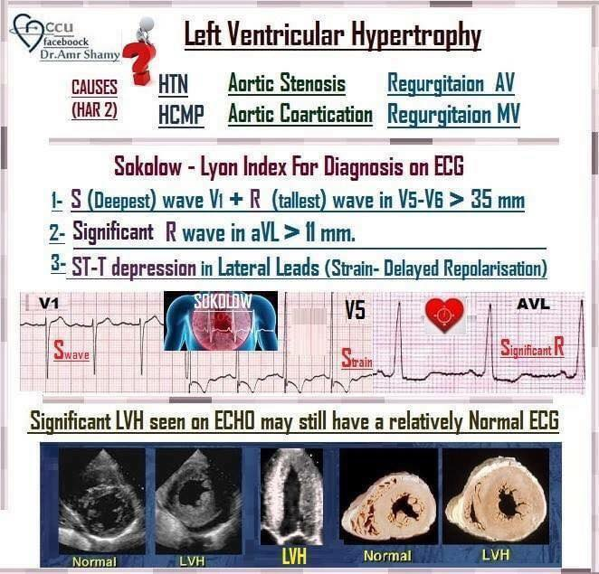
University of Basra
AL-Zahraa College of Medicine
Ministry of higher Education and Scientific Research

Slide 18
University of Basra
AL-Zahraa College of Medicine
Ministry of higher Education and Scientific Research

Slide 19
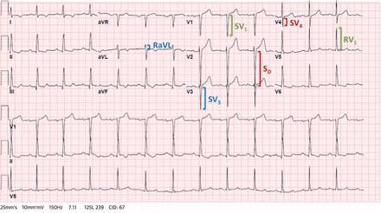
University of Basra
AL-Zahraa College of Medicine
Ministry of higher Education and Scientific Research

Slide 20
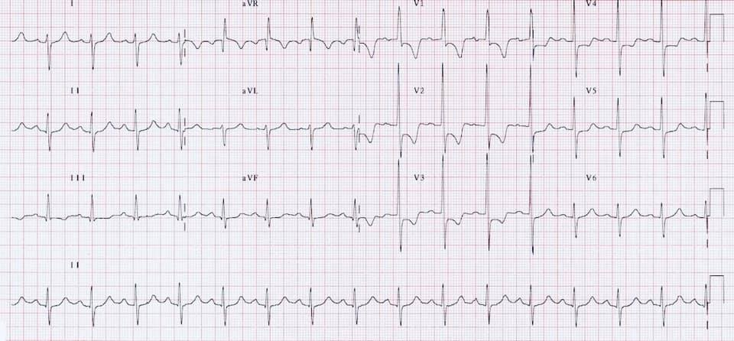
University of Basra
AL-Zahraa College of Medicine
Ministry of higher Education and Scientific Research

Slide 21
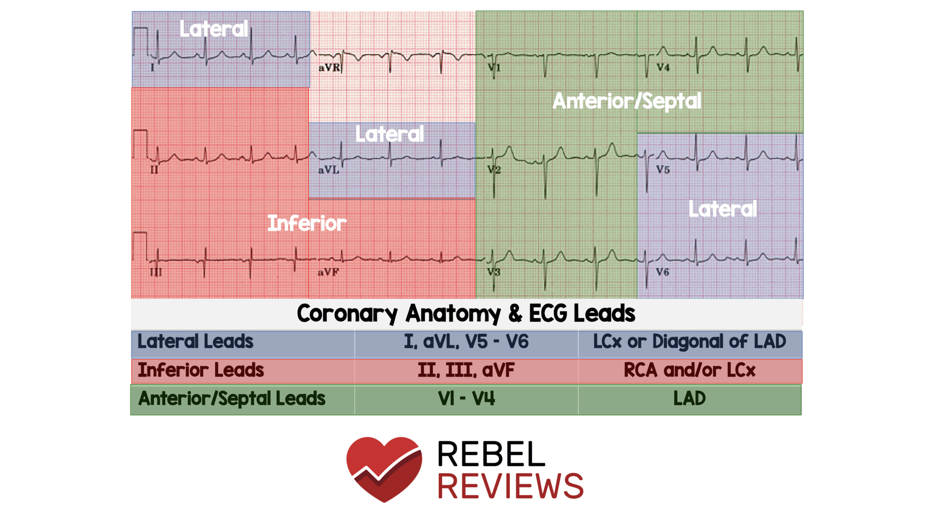
University of Basra
AL-Zahraa College of Medicine
Ministry of higher Education and Scientific Research
Check the ST segment:

Slide 22
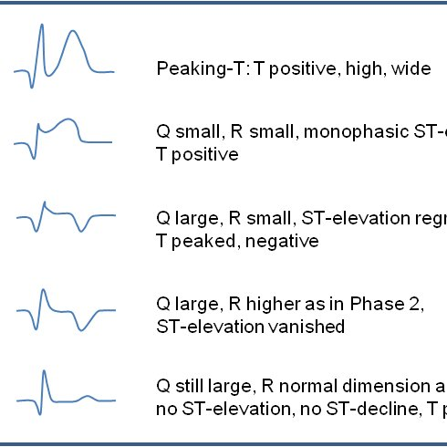
University of Basra
AL-Zahraa College of Medicine
Ministry of higher Education and Scientific Research
Check the ST segment:

Slide 23
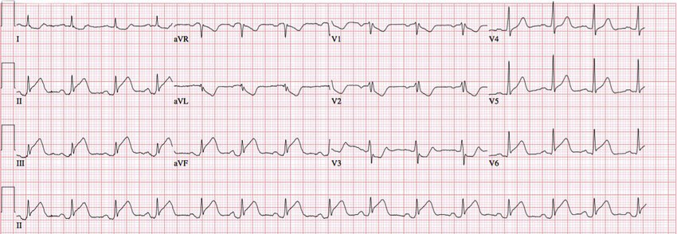
University of Basra
AL-Zahraa College of Medicine
Ministry of higher Education and Scientific Research

Slide 24
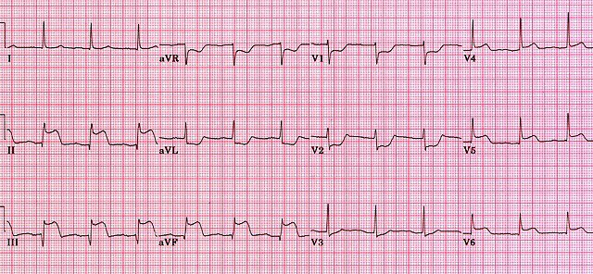
University of Basra
AL-Zahraa College of Medicine
Ministry of higher Education and Scientific Research

Slide 25
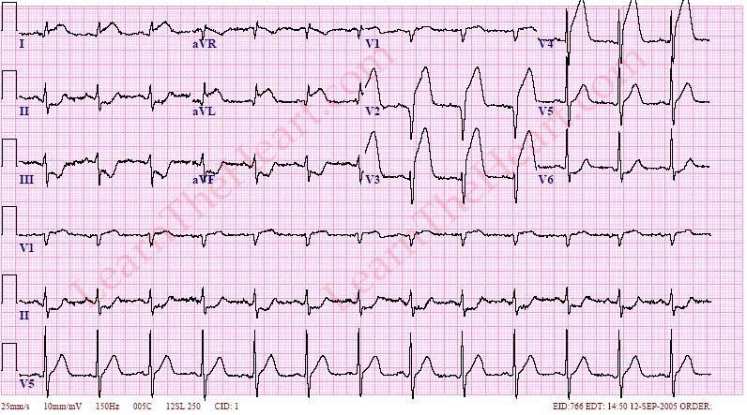
University of Basra
AL-Zahraa College of Medicine
Ministry of higher Education and Scientific Research

Slide 26
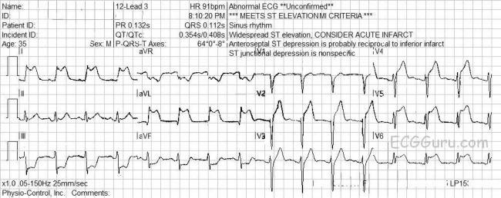
University of Basra
AL-Zahraa College of Medicine
Ministry of higher Education and Scientific Research

Slide 27
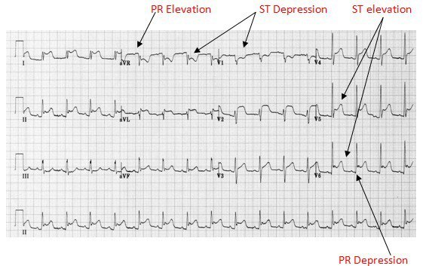
University of Basra
AL-Zahraa College of Medicine
Ministry of higher Education and Scientific Research

Slide 28
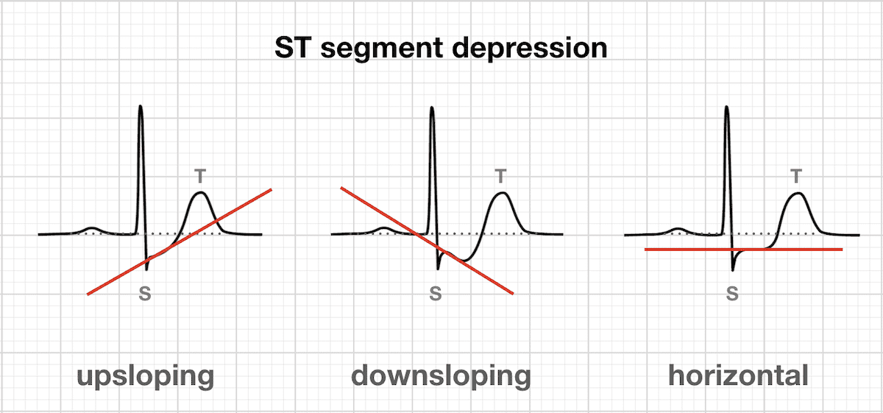
University of Basra
AL-Zahraa College of Medicine
Ministry of higher Education and Scientific Research

Slide 29
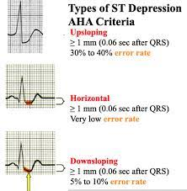
University of Basra
AL-Zahraa College of Medicine
Ministry of higher Education and Scientific Research

Slide 30
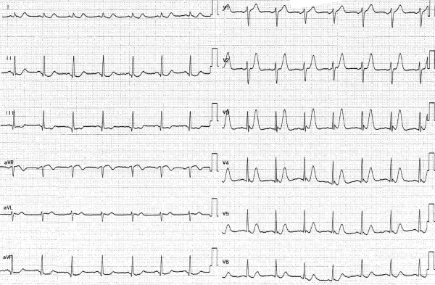
University of Basra
AL-Zahraa College of Medicine
Ministry of higher Education and Scientific Research
Check the T wave :

Slide 31
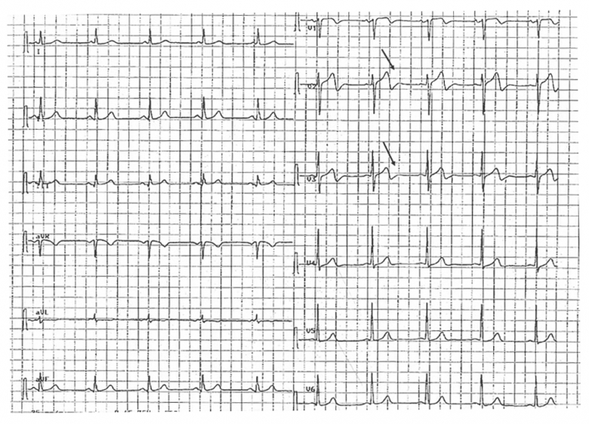
University of Basra
AL-Zahraa College of Medicine
Ministry of higher Education and Scientific Research

Slide 32
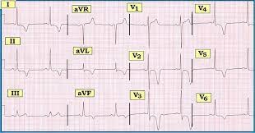
University of Basra
AL-Zahraa College of Medicine
Ministry of higher Education and Scientific Research

Slide 33
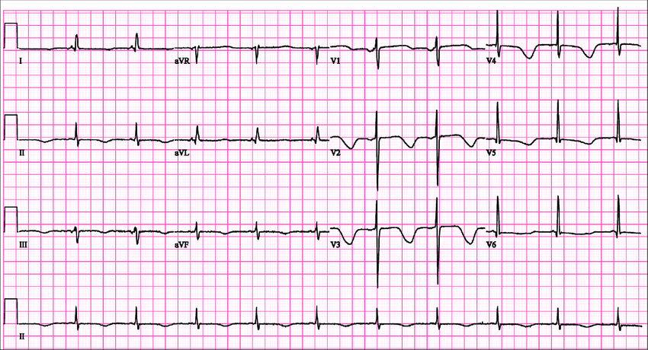
University of Basra
AL-Zahraa College of Medicine
Ministry of higher Education and Scientific Research

Slide 34
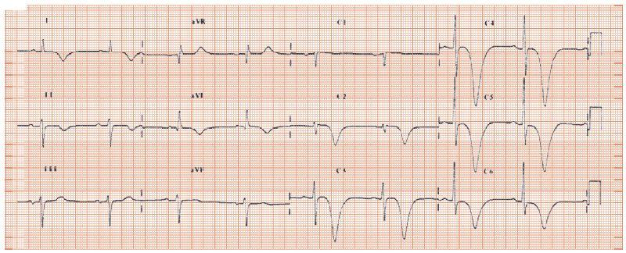
University of Basra
AL-Zahraa College of Medicine
Ministry of higher Education and Scientific Research

Slide 35
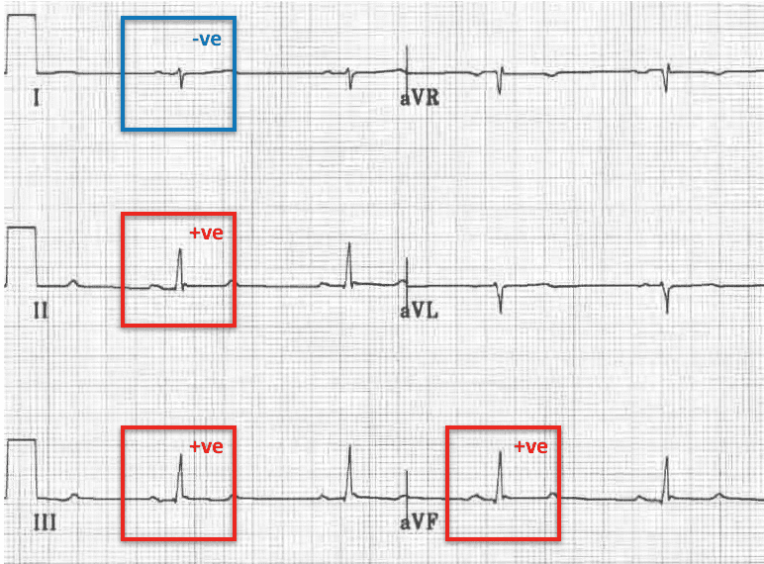
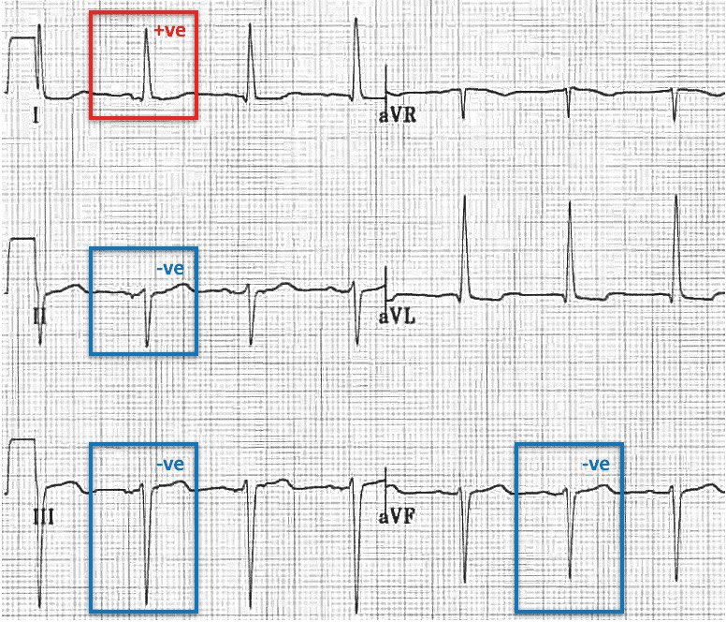
University of Basra
AL-Zahraa College of Medicine
Ministry of higher Education and Scientific Research
Check axis
RAD (reach)
LAD (leave)

Slide 36
University of Basra
AL-Zahraa College of Medicine
Ministry of higher Education and Scientific Research
Thank you

